Slide 1

UNIVERSITY INSTITUTE OF SCIENCES
Academic Unit V
Bachelor of Engineering
(Computer Science & Engineering)
Biology For Engineers
23SZT-148
Nervous System
DISCOVER . LEARN . EMPOWER

Slide 2
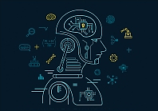

Course Outcome
CO Number | Title | Level
CO1 | Identify the biological concepts from an engineering perspective. | Remember
CO2 | Development of artificial systems mimicking human action. | Understand
CO3 | Explain the basic of genetics that helps to identify and formulate problems | Understand
CO4 | Apply knowledge of measurement system, biomedical recording system and biosensors to excel in areas such as entrepreneurship, medicine, government, and education. | Understand
CO5 | Integrate biological principles for developing next generation technologies
Will be covered in this lecture
https://images.app.goo.gl/5obqqxo93P2UBmdU6

Slide 3
SYLLABUS
Unit-2 | Biosensors and measurement system | Contact Hours: 15
Chapter 1 Medical Instrumentation Chapter 2 Measurement System Chapter 3 Biological Sensor | Medical Instrumentation: Sources of biomedical Signals, Basic medical Instrumentation system, Performance requirements of medical Instrumentation System, Microprocessors in Medical instruments, PC base medical Instruments, General constraints in the design of medical Instrumentation system, Regulation of Medical Devices. Measurement System: Specification of instruments, Statics & Dynamic characteristics of medical instruments, Classification of errors. Statistical analysis, Reliability, Accuracy, Fidelity, Speed of responses, Linearization of technique, and Data Acquisition System. Biological sensors: Sensors/ receptors in the human body, basic organization of the nervous system- neural mechanism, Chemoreceptor: hot and cold receptors, sensors for smell, sound, vision, Ion exchange membrane electrodes, enzyme, glucose sensors, immunosensors, & biosensors & applications of biosensors.

Slide 4
Nervous System
The nervous system is a network of neurons whose main feature is to generate, modulate and transmit information between all the different parts of the human body.
This property enables many important functions of the nervous system, such as regulation of vital body functions (heartbeat, breathing, digestion), sensation and body movements.

Slide 5
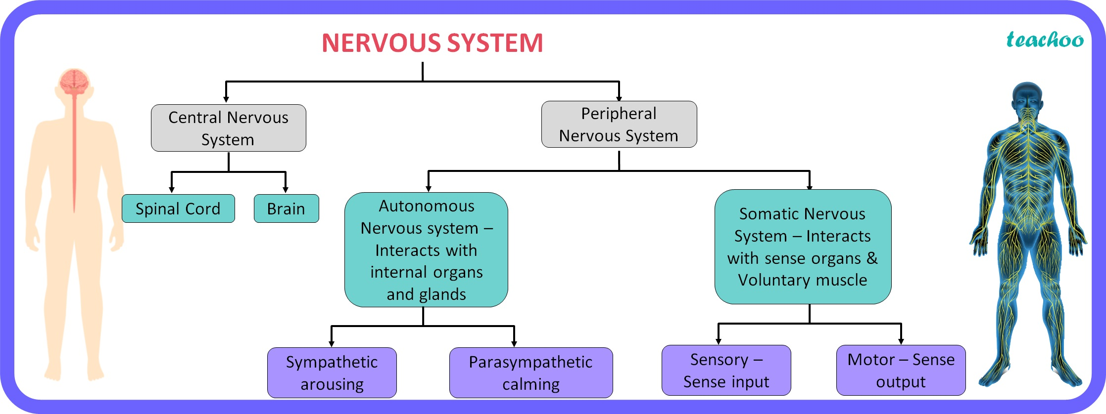
CLASSIFICATION OF NERVOUS SYSTEM
Voluntary muscles- action under control

Slide 6
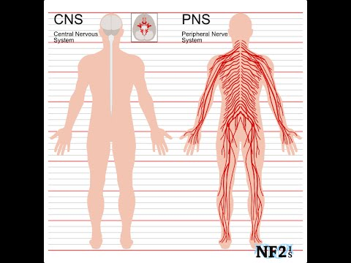
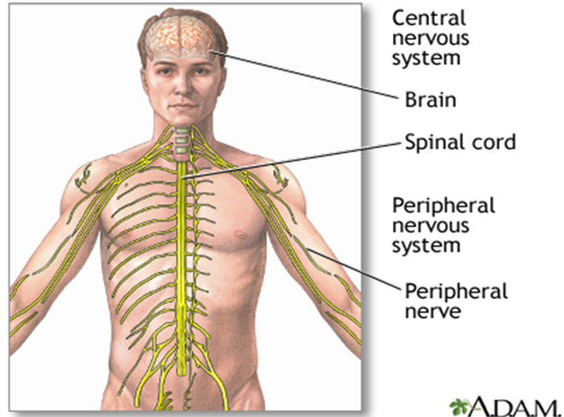

Slide 7
A. Central Nervous System: Brain and Spinal Cord
The central nervous system (CNS) consists of the brain and spinal cord.
Together these parts process the incoming information from peripheral tissues and generate commands; telling the tissues how to respond and function.
These commands tackle the most complex human body functions, from breathing to thinking.
Incoming information from PNS>>>>>>>>CNS>>>>> telling the tissues how to respond and function

Slide 8

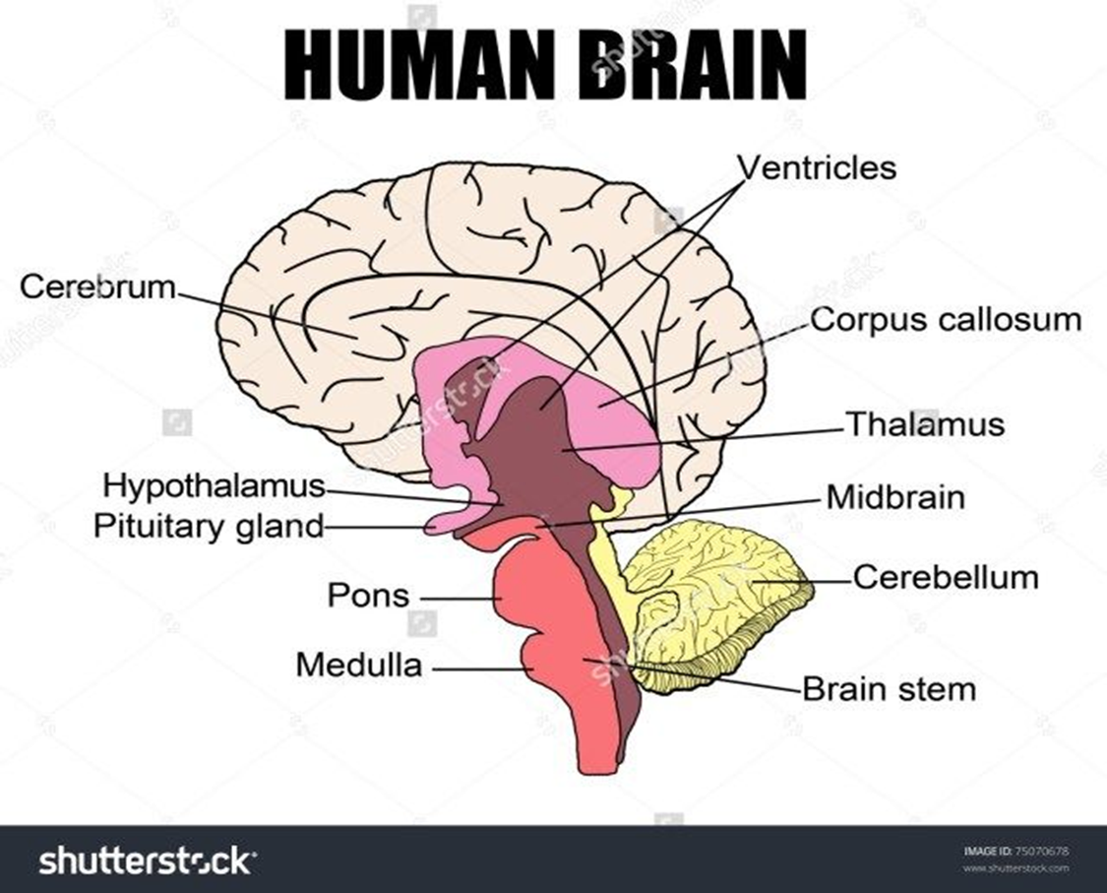
1. Brain
Brain is the largest and most complex mass of nervous tissue in the body.
Weighs about 3 pounds in adults (1.3 kg app.)
75% water
20% of oxygen
100 billion neurons
Controls body functions and interactions with the outside world.

Slide 9
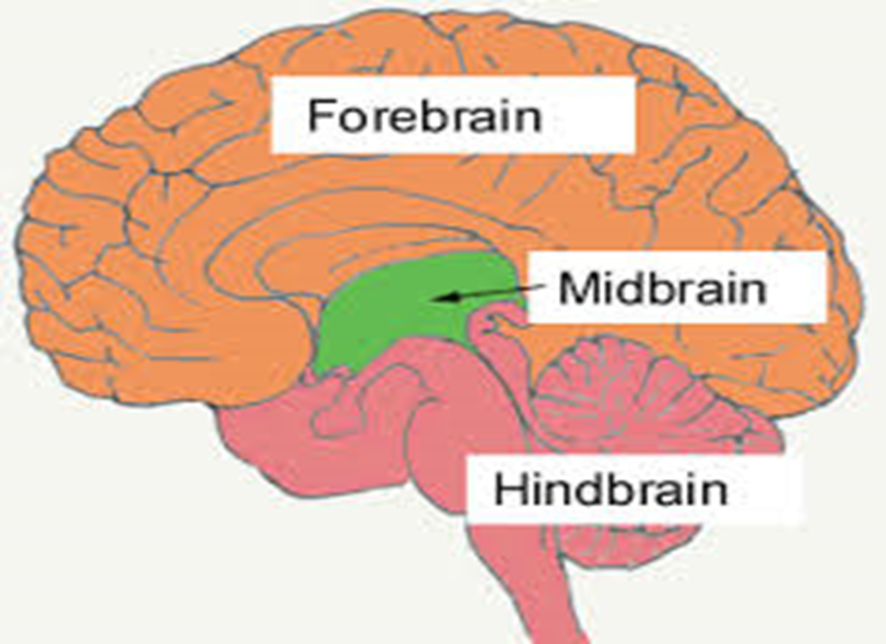
Parts of the human brain
The human brain is made up different compartments, for each of the functions. Take a look at the different parts of the brain.
Forebrain
Midbrain
Hind Brain

Slide 10

Forebrain
It is the main thinking part of the brain and controls the voluntary actions (controlled by will).
The forebrain processes sensory information that is collected from the various sense organs such as ears, eyes, nose, tongue, skin.
It is because of the presence of forebrain, humans are placed at the highest level in the animal chain.
The forebrain consists of the Cerebrum, Thalamus and Hypothalamus.

Slide 11
Mid Brain
The midbrain connects the forebrain and the hindbrain.
It acts as a bridge and transmits signals from hindbrain and forebrain.
It is associated with control, vision, hearing, temperature regulation, alertness.

Slide 12
Hind Brain
It controls heart rate, breathing, blood pressure, sleep and waking up functions etc.
The hindbrain has three parts, namely –
cerebellum
medulla oblongata
pons

Slide 13
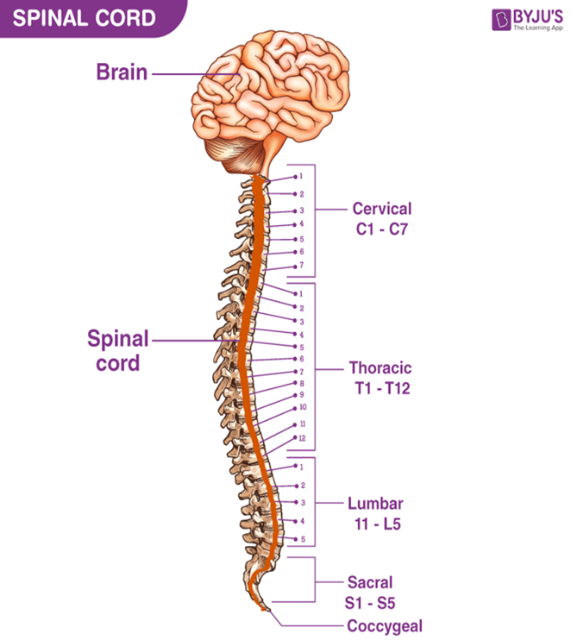
2. The spinal cord
The spinal cord is part of the central nervous system (CNS). It is situated inside the vertebral canal (space or cavity).
Like the vertebral column, the spinal cord is divided into segments: cervical, thoracic, lumbar, sacral, and coccygeal. Each segment of the spinal cord provides several pairs of spinal nerves, which exit from vertebral canal
(a total of 31 pairs).

Slide 14
B. The peripheral nervous system
The peripheral nervous system (PNS) consists of all the nerves branching out of the brain and spinal cord (the central nervous system, CNS).
If you imagine the CNS as the main highway, then the PNS forms all the connecting secondary roads.
These allow electrical impulses to travel to and from the furthest regions, or periphery, of the human body.
Functionally, the PNS can be divided into : autonomic and somatic nervous systems.

Slide 15
AUTONOMIC NERVOUS SYSTEM
The autonomic nervous system is the part of the nervous system that supplies the internal organs, including the blood vessels, stomach, intestine, liver, kidneys, lungs, pupils, heart, and sweat, salivary, and digestive glands.
Blood pressure
Heart and breathing rates
Body temperature
Digestion
Metabolism (thus affecting body weight)
The balance of water and electrolytes (such as sodium and calcium)
The production of body fluids (saliva, sweat, and tears)
Urination
Interact with internal organ and glands

Slide 16
Somatic nervous system
The somatic nervous system is a component of the peripheral nervous system associated with the voluntary control of the body movements.
Interact with Sense organs and voluntary muscles

Slide 17
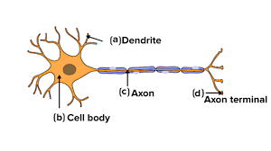
Neuron
Structural and functional unit of the neural tissue.
Human neural system has about 100 billion neurons.
Consists of a cell body, dendrites, an axon, an axon terminal.
a) Cell body:
It varies in size and 13.5 µm in diameter and may be irregular, spherical, oval, rounded, star-shaped or pyramidal.
Consists of cytoplasm, nucleus and cell membrane.
Cytoplasm has mitochondria, Golgi apparatus, rough endoplasmic reticulum, ribosomes, lysosomes, fat globules, pigment granules, neurofibrils and Nissl’s granules.
1 µm = 0.0001 cm

Slide 18
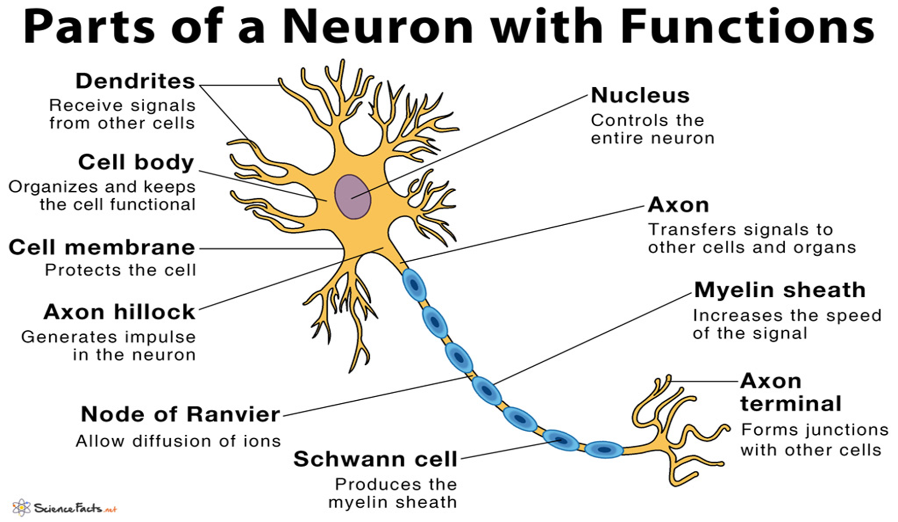

Slide 19
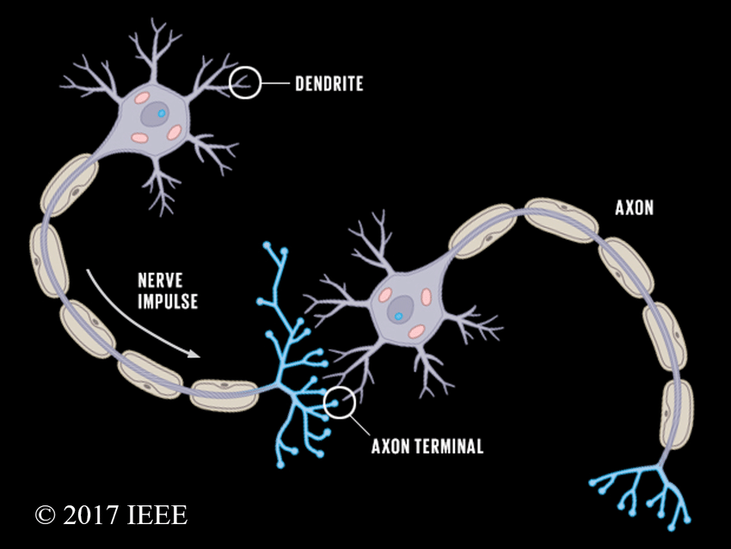
b) Dendrites (Dendrons):
These are usually shorter and much branched. They may be one to several. The dendrites contain neurofibrils, neurotubules. They conduct nerve impulse towards the cell body and are called afferent processes (= receiving processes).
c) Axon:
Long, slender projections
Conduct electrical impulses
Most sensitive part
Contain neurofibrils and neurotubules
d) Axon terminals:
The axon ends in a group of branches, the terminal arborizations (= axon terminals).
When terminal arborizations of the axon meet the dendrites of another neuron to form a synapse they form synaptic knobs (= end plates).

Slide 20
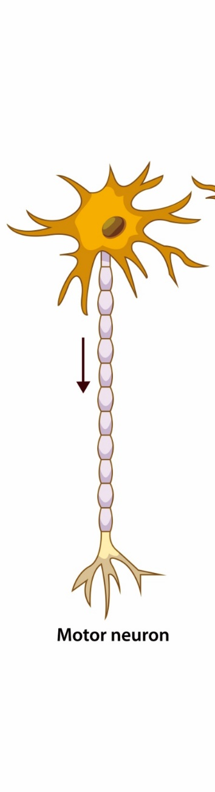


Types of Neurons
Efferent (Motor neurons): Transmit messages from the brain to muscles.
Afferent (Sensory neurons): Carry messages from sensory receptors to brain.
Interneuron: Carry messages between different neurons in body.

Slide 21
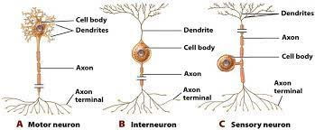
CNS- Brain

Slide 22
REFERENCES
The Human Nervous System. by Juergen K. Mai (Editor), George Paxinos AO (BA MA PhD DSc) NHMRC Dr. (Editor)
The Structure and Function of Nervous Tissue. Volume IV: Physiology and Biochemistry. Ed. GEOFFREY H. BOURNE (1972)
Elaine.N. Marieb,“Essential of Human Anatomy and Physiology”, Eight edition, Pearson Education NewDelhi, 2007.
William F. Ganong,"Review of Medical Physiology, 22nd edition, McGraw Hill New Delhi,
2005
Eldra Pearl Solomon."Introduction to Human Anatomy and Physiology", W.B.Saunders Company, 2003.
Arthur C. Guyton, "Text book of Medical Physiology", 11 th Edition, Elsevier Saunders, 2006
Khandpur. R. S., “Handbook of Biomedical Instrumentation”, Prentice Hall of India, New Delhi, 2003.
How does the nervous system work? 2009 Oct 28 [Updated 2016 Aug 19]. Available from: https://www.ncbi.nlm.nih.gov/books/NBK279390/
https://www.kenhub.com/en/library/anatomy/the-nervous-system
https://nurseslabs.com/nervous-system/
https://courses.lumenlearning.com/boundless-ap/chapter/introduction-to-the-nervous-system/

Slide 23
THANK YOU

